Slide 1

Round Robin Final Presentation
August 12, 2024

Slide 2
Priors for Calibration of Low Fidelity
Constant | Mean | Standard Deviation
k | 25788 | 0.04
b | 18.206 | 0.05
g₀ | 26 | 0.02
k_{f} | 722 | 0.07
b_{f} | 0.176 | 0.02

Slide 3
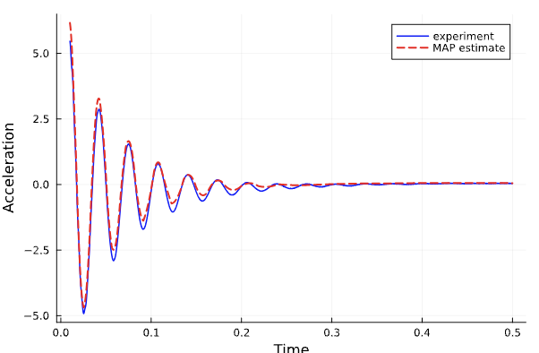
MAP Estimate of Low Fidelity Model
k | 26830 N/m
b | 9.6 Ns/m
g₀ | 21.4 Ns/m
k_{f} | 877 N/m
b_{f} | 0.175 Ns/m
x₁ | 0.00026
x₂ | 0.00045
v₁ | 0.0091
v₂ | 0.0095

Slide 4
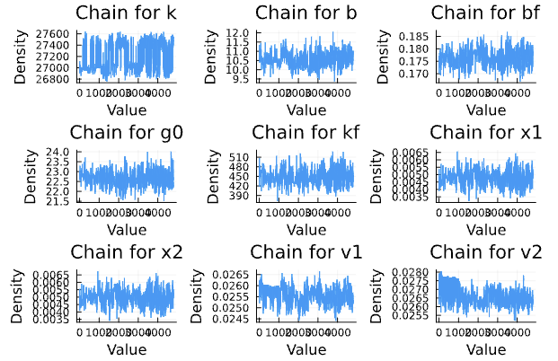
Chains of Calibration for Low Fidelity

Slide 5
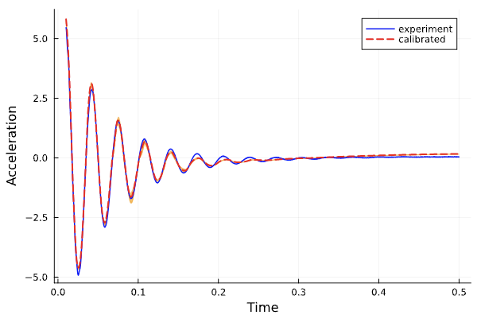
Calibrated Low Fidelity Model
Validation Fraction = 0.003986
All validation was done with 95% confidence interval

Slide 6
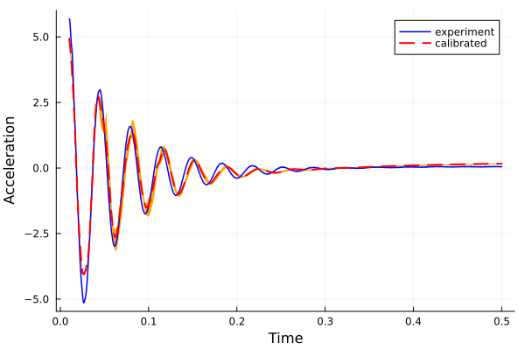
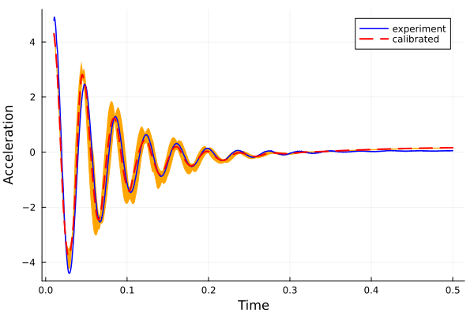
Low Fidelity Model Calibration Constants for Different Masses
m=0.9249
m=1.0613
Validation = 0.0869
Validation = 0.0618

Slide 7
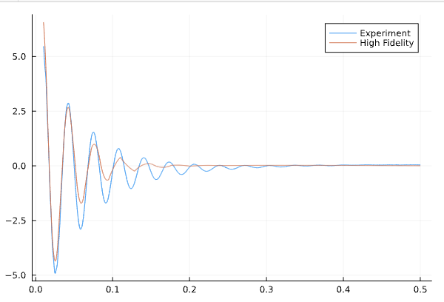
Inadequacy Operator for High Fidelity Model
$$\ddot{z}\left(t\right)=\frac{1}{m}\left[−b\left(\dot{z}\left(t\right)−{\dot{z}}_{f}\left(t\right)\right)−F_{a}\left(\dot{z}\left(t\right)\right)−\left\{k\left(z\left(t\right)−z_{f}\left(t\right)\right)+k_{1}\left|z\left(t\right)−z_{f}\left(t\right)\right|\left(z\left(t\right)−z_{f}\left(t\right)\right)+k_{2}{\left(z\left(t\right)−z_{f}\left(t\right)\right)}^{3}\right\}\right]$$
$${\ddot{z}}_{f}\left(t\right)=\frac{1}{m_{f}}\left[b\left(\dot{z}\left(t\right)−{\dot{z}}_{f}\left(t\right)\right)+k\left(z\left(t\right)−z_{f}\left(t\right)\right)−b_{f}{\dot{z}}_{f}\left(t\right)−k_{f}z_{f}\left(t\right)\right]$$

Slide 8
Priors for Calibration of High Fidelity
Constant | Mean | Standard Deviation
k | 25788 | 0.04
b | 18.206 | 0.05
g₀ | 26 | 0.02
k_{f} | 722 | 0.07
b_{f} | 0.176 | 0.02
Constant | Mean | Standard Deviation
k₁ | 500 | 0.05
k₂ | 20000 | 0.03

Slide 9
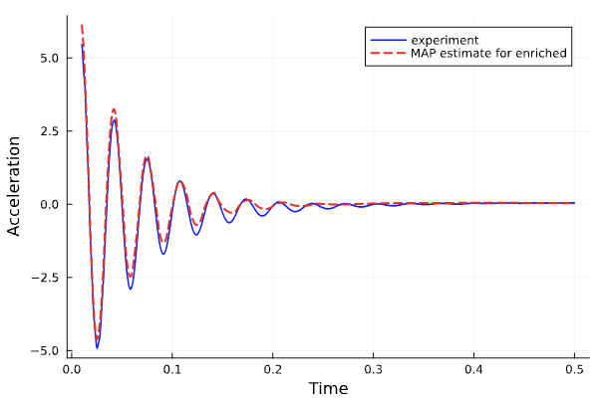
MAP Estimate of High Fidelity Model
k | 26680 N/m
b | 9.6 Ns/m
g₀ | 21.8 Ns/m
k_{f} | 916N/m
b_{f} | 0.179 Ns/m
k₁ | 504 N/m²
k₂ | 20492 N/m³
x₁ | 0.0003
x₂ | 0.00049
v₁ | 0.0068
v₂ | 0.0065

Slide 10
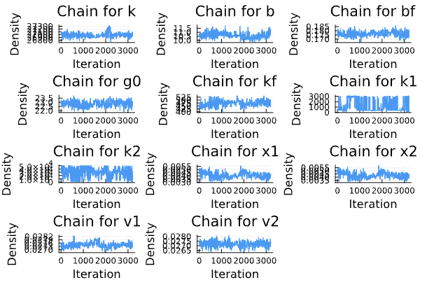
Chains of Calibration for High Fidelity

Slide 11
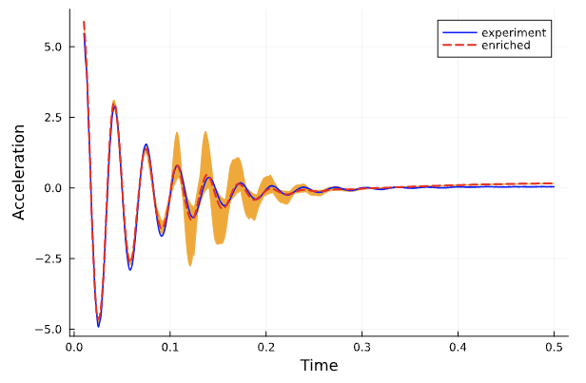
Calibrated High Fidelity Model
Validation Fraction= 0.00199

Slide 12
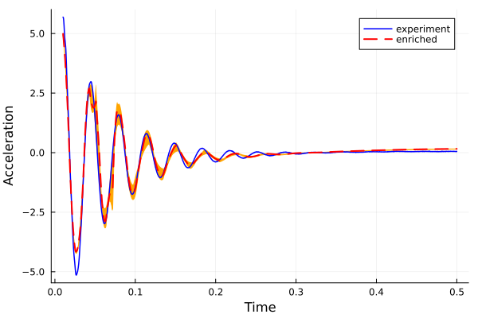
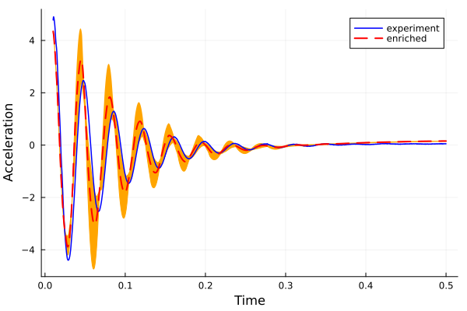
High Fidelity Model Calibration Constants for Different Masses
m=0.9249
m=1.0613
Validation = 0.0546
Validation = 0.0937

